Slide 1
PANIMALAR ENGINEERING COLLEGE B.E COMPUTER SCIENCE AND ENGINEERING
MAP FOR PEC WITH AI CHATBOT
21CS1503 -
SOCIALLY RELEVANT MINI PROJECT
PALLAVI.S(211422104332)
RAJESHWARI.C(211422104374)

Slide 2
ABSTRACT
Navigating large college campuses can be a daunting task, especially for new students and visitors.
This project aims to develop a user-friendly digital platform integrating an interactive campus map with an AI chatbot.
Users can engage in real-time, conversational interactions with the chatbot to receive accurate and instant guidance.
The integration of the AI chatbot with the map enhances the user experience by providing dynamic, personalized responses based on location and specific queries.
The college map will also provide a detailed layout of buildings, departments, facilities, and services, allowing users to easily locate their desired destinations.

Slide 3
INTRODUCTION
The interactive map will provide a comprehensive view of the campus layout, while the AI chatbot will offer real-time assistance by answering location-based questions and providing personalized recommendations.
The platform is designed to be user-friendly, regardless of the skill level, ensuring that students, faculty, and visitors can easily navigate the campus.
Additionally, the AI chatbot can provide valuable information beyond directions, such as details about ongoing campus events, department contacts, and administrative services.

Slide 4
PROBLEM STATEMENT
Large college campuses can be difficult to navigate, especially for new students, visitors, and even faculty members.
Finding specific buildings, departments, services, or event venues often requires significant time and effort.
The PEC College Map with AI Chatbot aims to solve these issues by combining an interactive campus map with an AI-driven chatbot that can provide real-time, personalized assistance.
The system will allow users to easily locate their desired destinations, while the AI chatbot will answer specific queries related to navigation, events, and campus services, thereby improving the overall campus experience for all users.

Slide 5
EXISTING SYSTEM
Google Maps is designed for general public use and may not have specific campus details, such as indoor maps for college buildings or precise information on facilities like classrooms, offices, or event venues.
WAZE is primarily a driving focused map not useful for walking directions or indoor navigation, which are inevitable on most college campuses.

Slide 6
PROPOSED SYSTEM
Interactive Digital Campus Map
The system will feature a detailed, interactive map of the entire college campus, accessible on any device.
AI-Powered Chatbot
The AI chatbot, integrated with the map, will provide real-time, conversational assistance to users.
User-Friendly Interface
A simple and intuitive interface for both the map and chatbot, allowing users of all skill levels to navigate the system easily.
Customized Maps for College
Our project aims to create a custom and tailor-made college map for the visitors to reduce their daily hassle.
This Map also offers college-specific information.

Slide 7
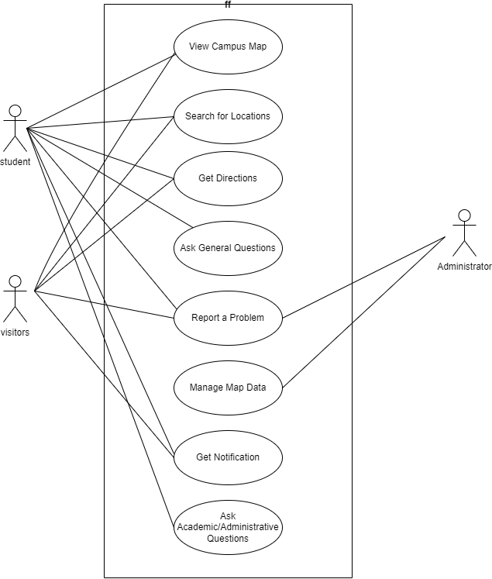
USECASE DIAGRAM

Slide 8
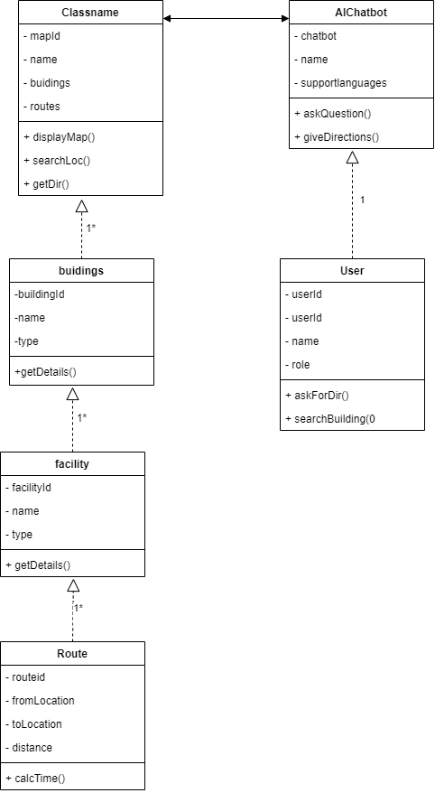
CLASS DIAGRAM

Slide 9
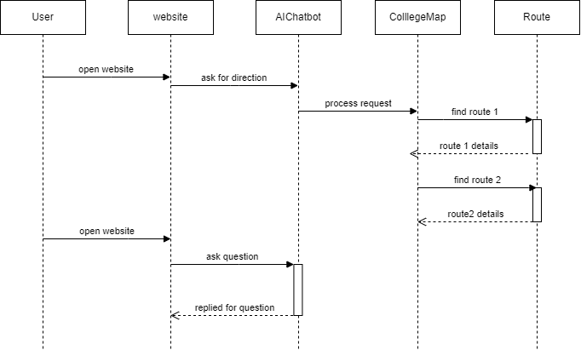
SEQUENCE DIAGRAM

Slide 10
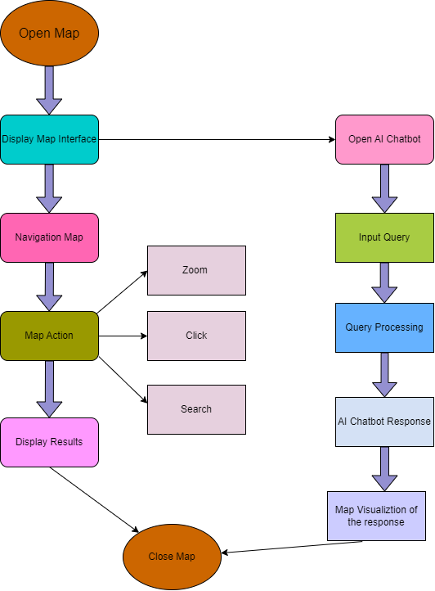
FLOWCHART

Slide 11
SYSTEM MODULES AND COMPONENTS:
User Interaction with Map:
The user starts by interacting with the map system. They may perform actions such as searching for locations, zooming, and clicking on points of interest.
User Query via AI Chatbot:
While using the map, the user can initiate a conversation with the AI chatbot to ask for further information or clarification.
Final Interaction:
After the user has received both map and chatbot responses, they can close the map, ending their interaction with the system.

Slide 12
RESULTS:
By combining real-time location services with personalized assistance, the chatbot can provide directions, building information, and event details while adapting to the user’s specific needs.
This seamless fusion of technology enhances the campus experience by reducing confusion, improving accessibility, and promoting efficiency.
As AI continues to evolve, the potential for expanding these capabilities—like integrating academic resources or personalized tour suggestions—promises to make campus life more connected and user-friendly.
Ultimately, the AI chat bot represents a forward-thinking strategy that aligns with the institution's mission to leverage technology for the betterment of the academic experience.
.

Slide 13
FUTURE ENHANCEMENTS:
1. Augmented Reality (AR) Integration: Users could access an AR view through their smart phones, where the AI chat bot provides real-time directions and overlays useful information on campus landmarks, helping users visually navigate their environment.
2.Personalized Recommendations: The chatbot could offer tailored suggestions based on user preferences, such as study spots, nearby amenities, or events related to their academic or extracurricular interests.
3. Crowdsourced Feedback and Collaboration: Students and staff could contribute by submitting feedback or reporting inaccuracies, allowing the AI system to improve its data and provide better, more accurate guidance.
4. Integration with Academic Resources: The AI chatbot could link directly to course schedules, library catalogs, or tutoring services, allowing students to not only find buildings but also access academic resources on the go.
5. Social Features: Community building: The chatbot could be used to connect students with each other and campus resources .Event planning: The chatbot could help students plan and organize campus events.

Slide 14
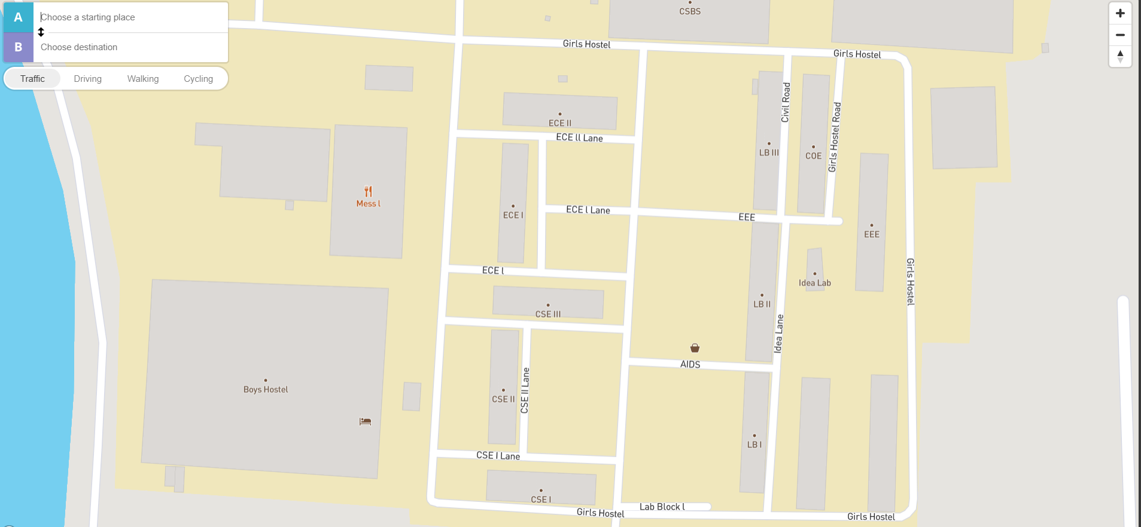
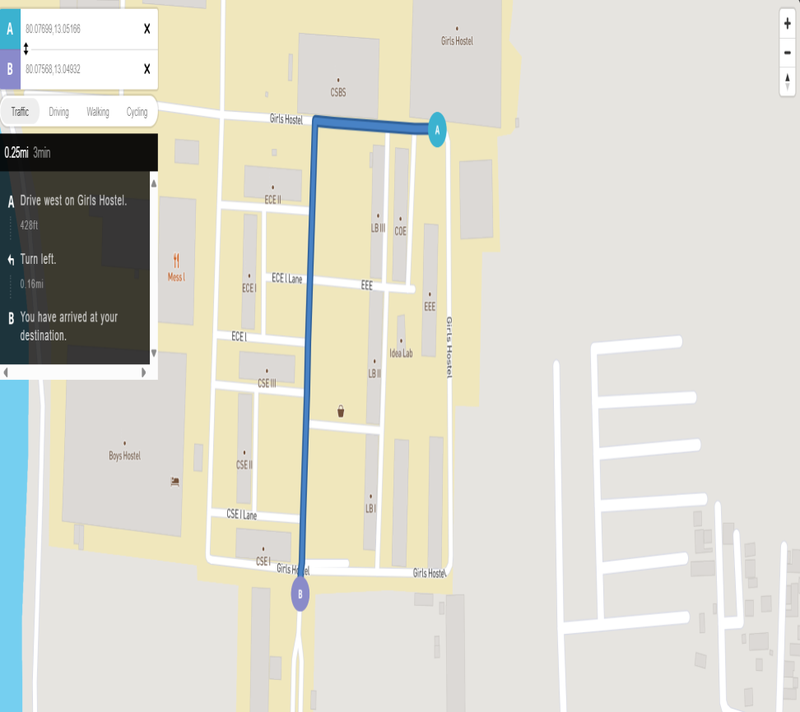
SAMPLE SCREENSHOTS

Slide 15
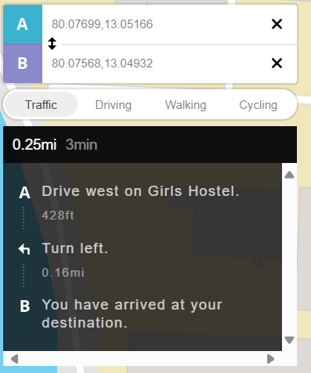
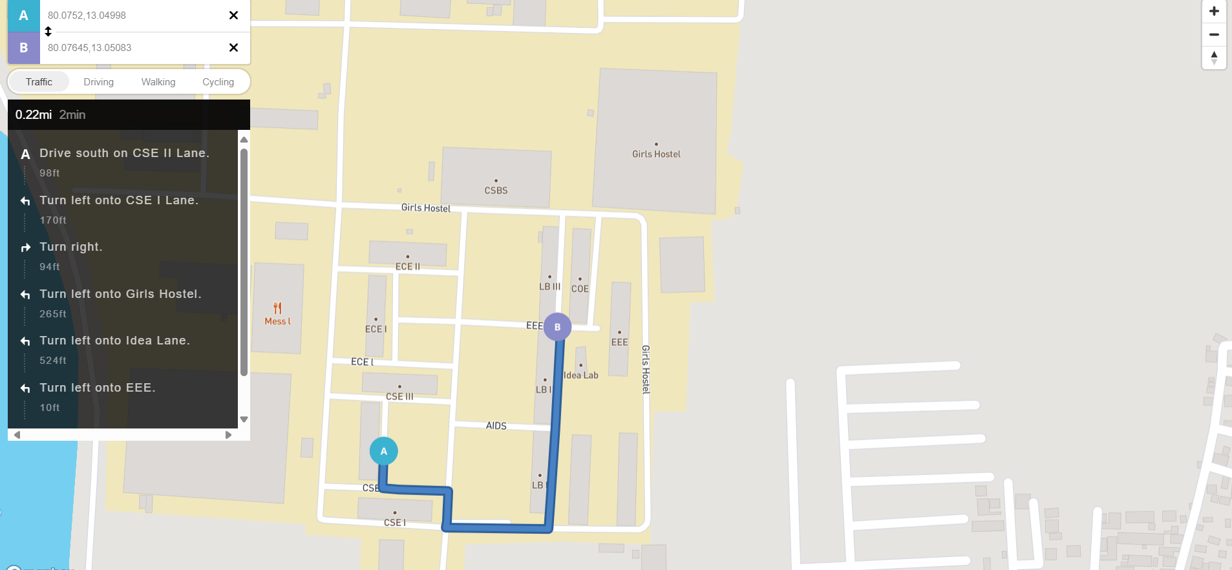

Slide 16
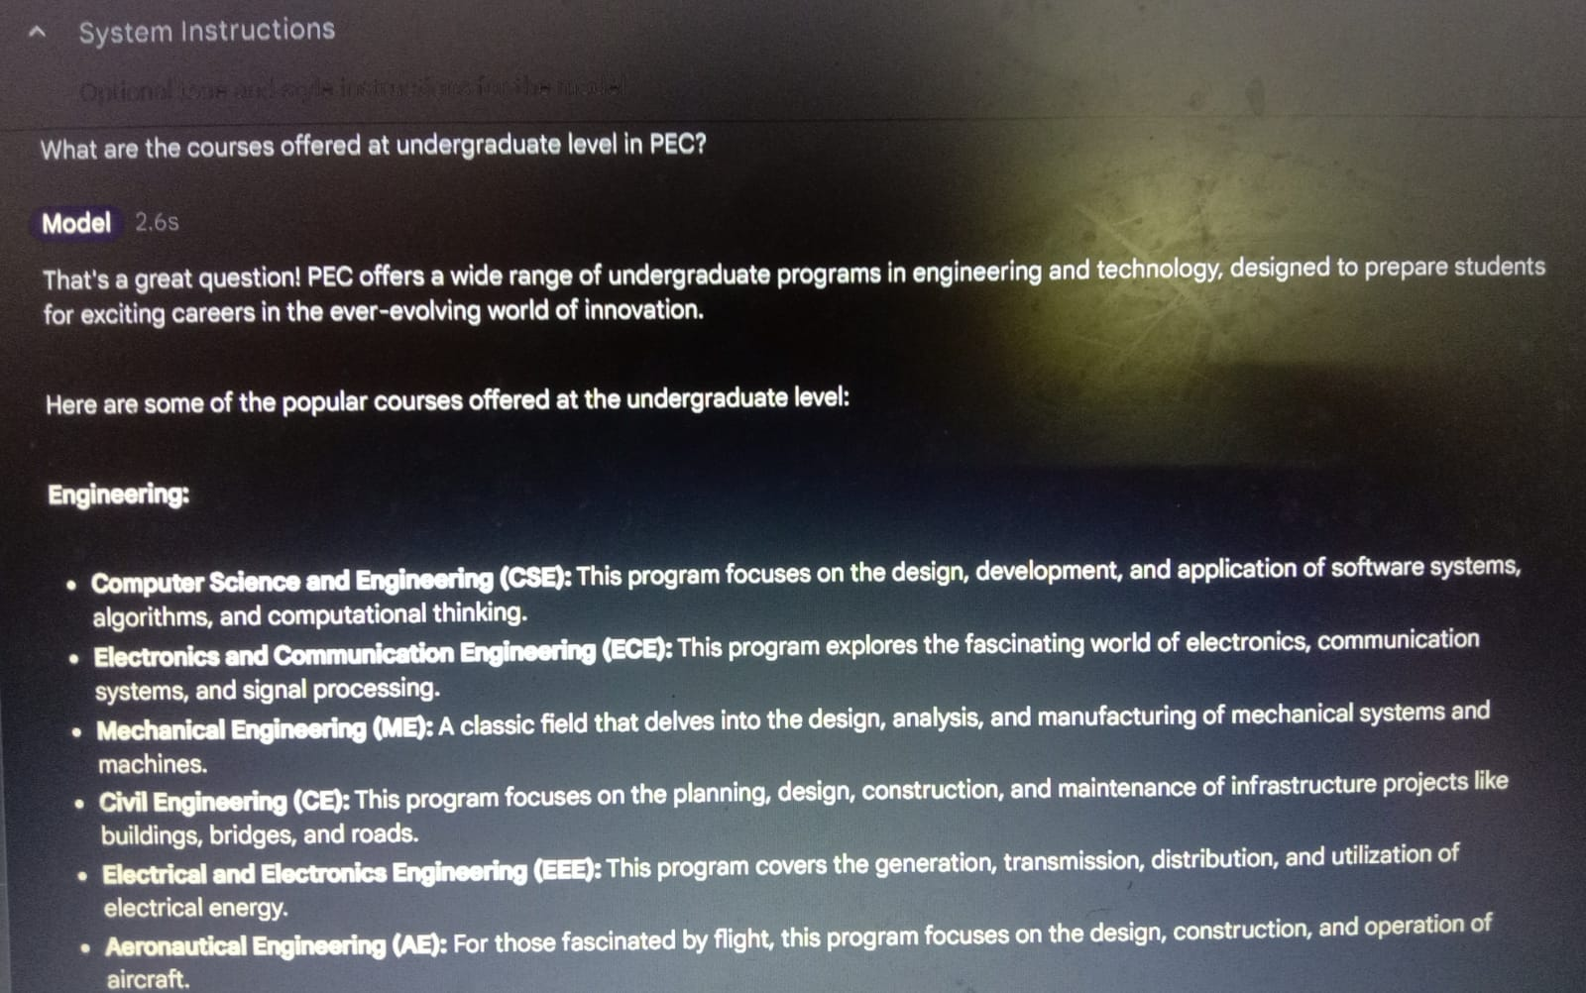
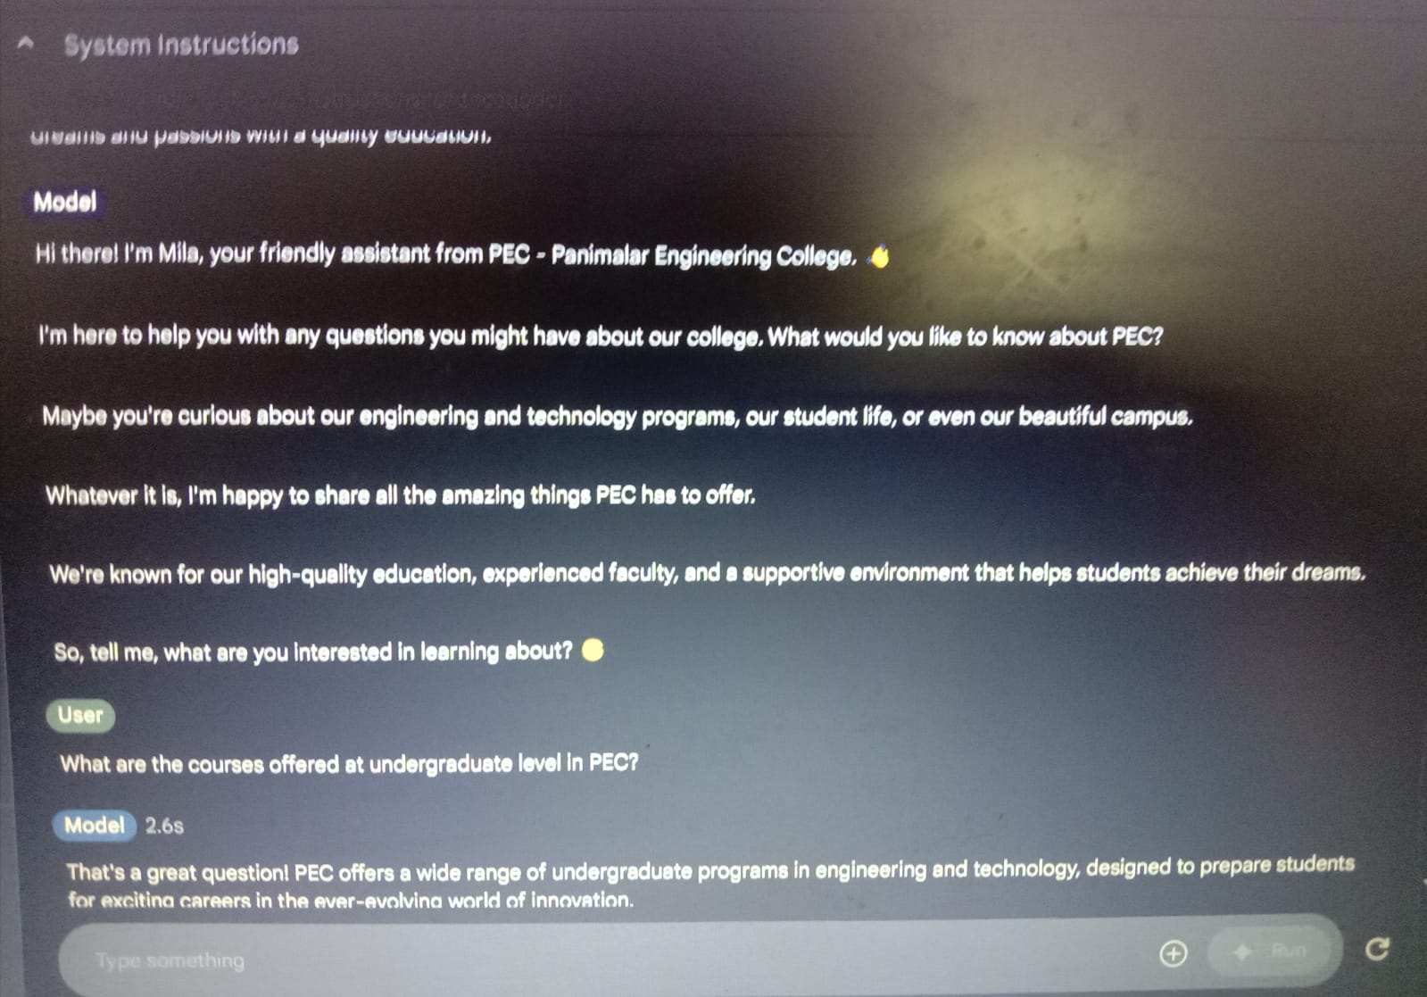

Slide 17
THANK YOU!
We sincerely thank our management for letting us showcase our project and our Mentor for guiding us throughout the project.

